Slide 1
Deep Learning (DNN)
Unit - 02

Slide 2

Neural Network Architecture
Deep neural network (DNN) is a subset of machine learning concerned with models based on many-layered neural networks.
It is deep learning in the sense that its models learn from many layers of transformations.
Typical DNN architecture consists of three distinct types of layers:
The input layer
The hidden layers (two or more)
The output layer

Slide 3
Uses and Advantages of Deep Neural Networks
The problems of learning from the raw audio signal, the raw pixel values of images, or the mapping between sentences of arbitrary lengths and their counterparts in foreign languages, are those where deep learning excels over traditional methods.
The architecture of DNN allows the model for end-to-end training, that is all internal parameters are tuned jointly during training.
By replacing the domain-specific preprocessing of the data, deep learning has eliminated many boundaries that previously separated computer vision, speech recognition, natural language processing, medical informatics, and other application areas, thus offering a unified set of tools for tackling diverse problems.
The abundance in data arising from cheap sensors and internet-scale applications, together the significant progress in computational capacity through GPUs and the releasing of many excellent open-source libraries have spawned tremendous developments in deep learning.

Slide 4
The Input Layer
The nodes of the input layer get data values and do not change the data.
The nodes of the input are connected to the nodes of the first hidden layer.
The input layer is different from the other layers (nodes are passive)

Slide 5
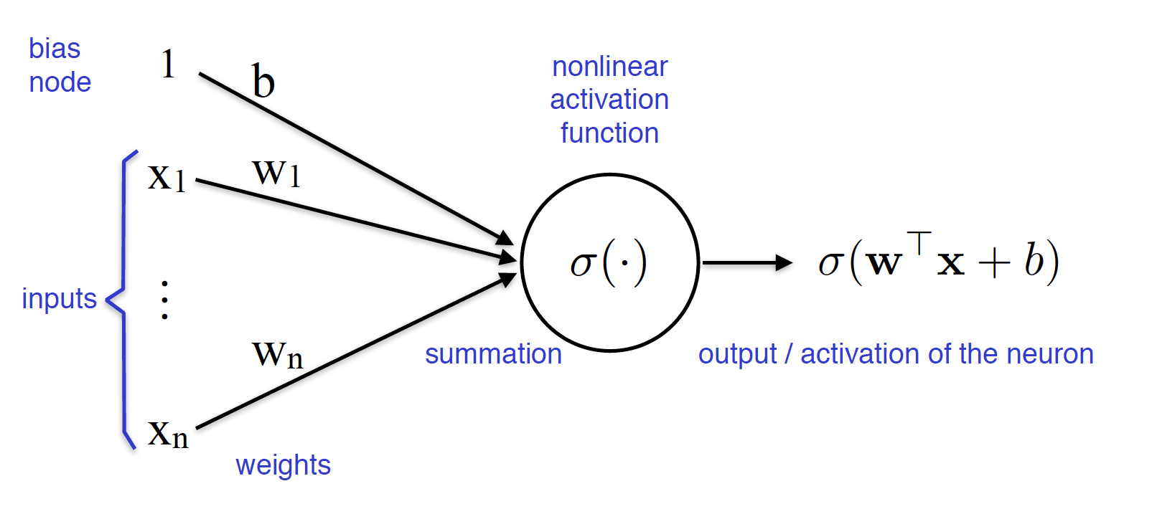
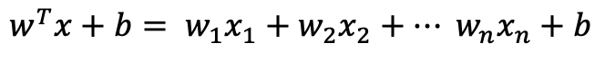
The Hidden Layers
The nodes of a hidden layer are connected to the nodes of the previous layer by links representing weights (w) and biases (b).
Each node of a hidden layer is a non-linear function (activation function).
The input of an activation function is a linear combination of the outputs of the previous layer and the weights and bias.
$$w^{T}x+b= w_{1}x_{1}+w_{2}x_{2}+… w_{n}x_{n}+b$$

Slide 6
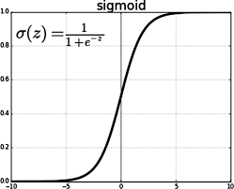
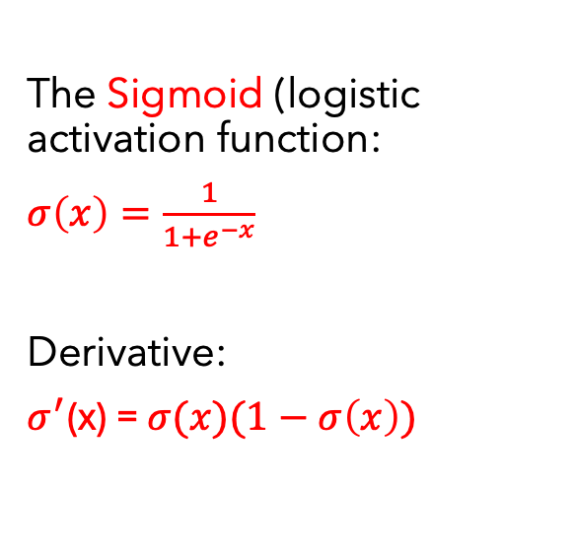
Activation Functions for the Hidden Layers
The Sigmoid (logistic activation function:
$σ\left(x\right)=\frac{1}{1+e^{−x}}$
Derivative:
$σ^{′}$(x) = $σ(x)(1−σ\left(x\right))$

Slide 7
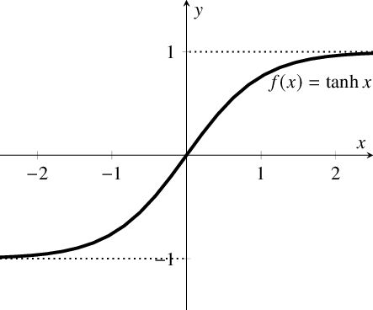
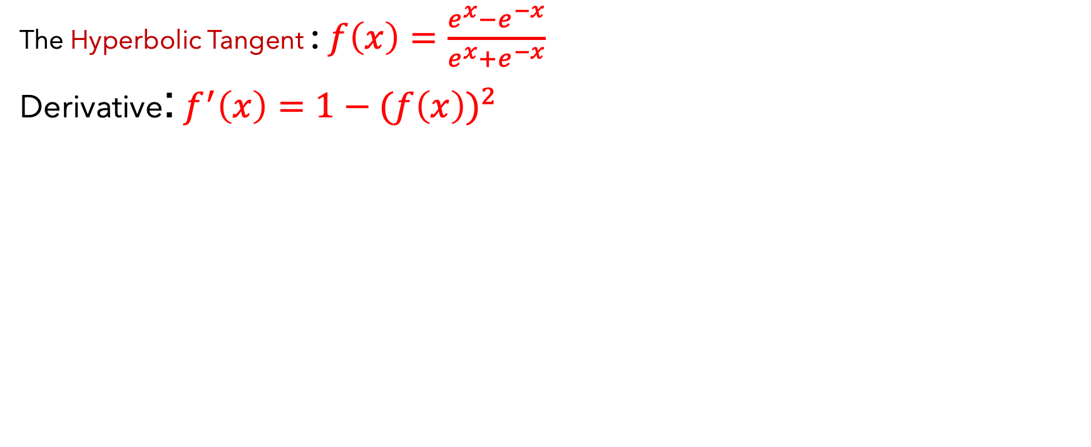
Activation Functions for the Hidden Layers
The Hyperbolic Tangent : $f\left(x\right)=\frac{e^{x}−e^{−x}}{e^{x}+e^{−x}}$
Derivative: $f^{′}\left(x\right)=1−{(f\left(x\right))}^{2}$

Slide 8

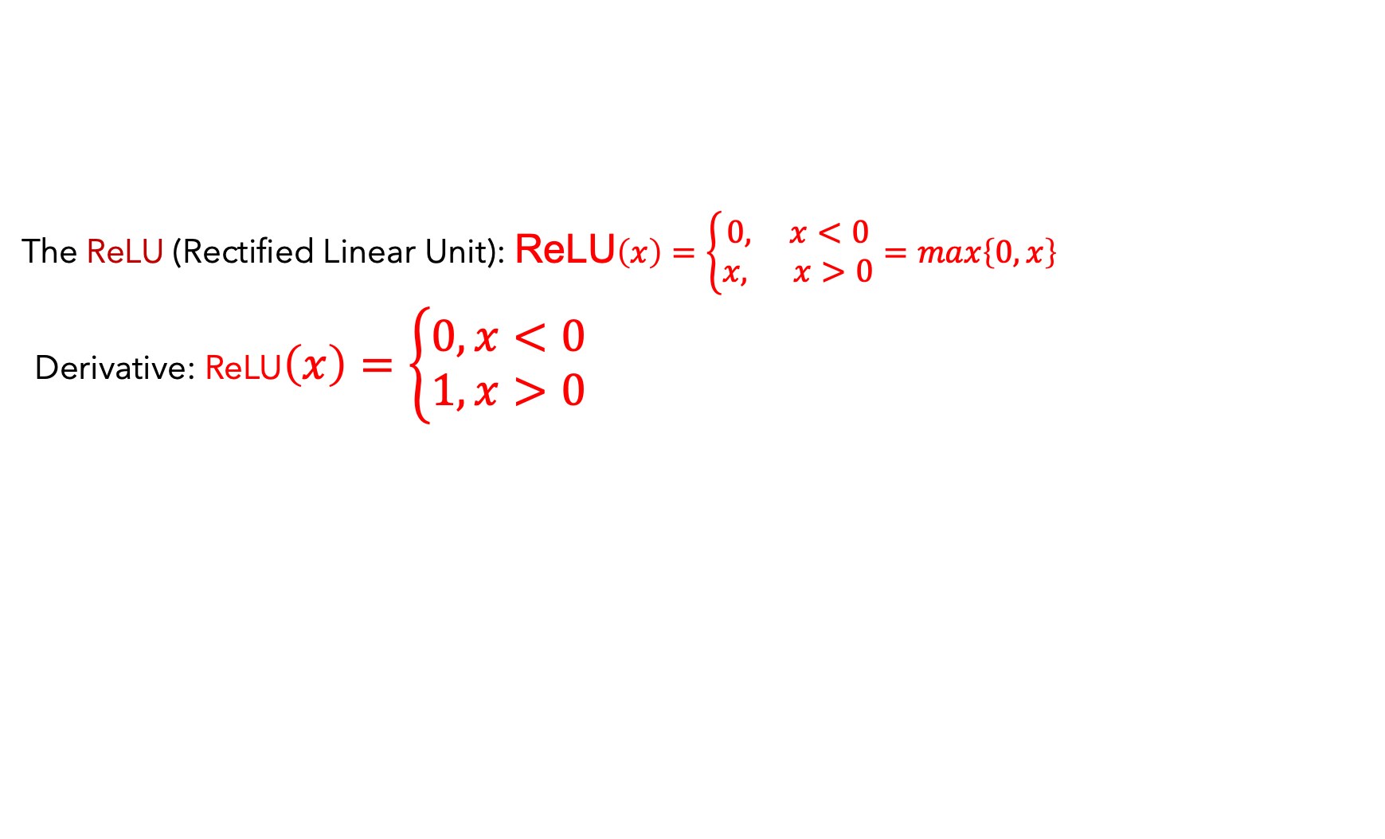
Activation Functions for the Hidden Layers
The ReLU (Rectified Linear Unit): ReLU$\left(x\right)=\left\{\begin{aligned}0, x<0 \\ x, x>0\end{aligned}\right.=max\left\{0, x\right\}$
Derivative: ReLU$\left(x\right)=\left\{\begin{aligned}0, x<0 \\ 1, x>0\end{aligned}\right.$

Slide 9
The Output Layer
The nodes of the output are connected to the nodes of the last hidden layer.
Each node is an activation (non-linear) function whose values correspond to a probability distribution.
The input of the activation function is a linear combination of the outputs of the last hidden layer with weights and bias represented by the links.

Slide 10
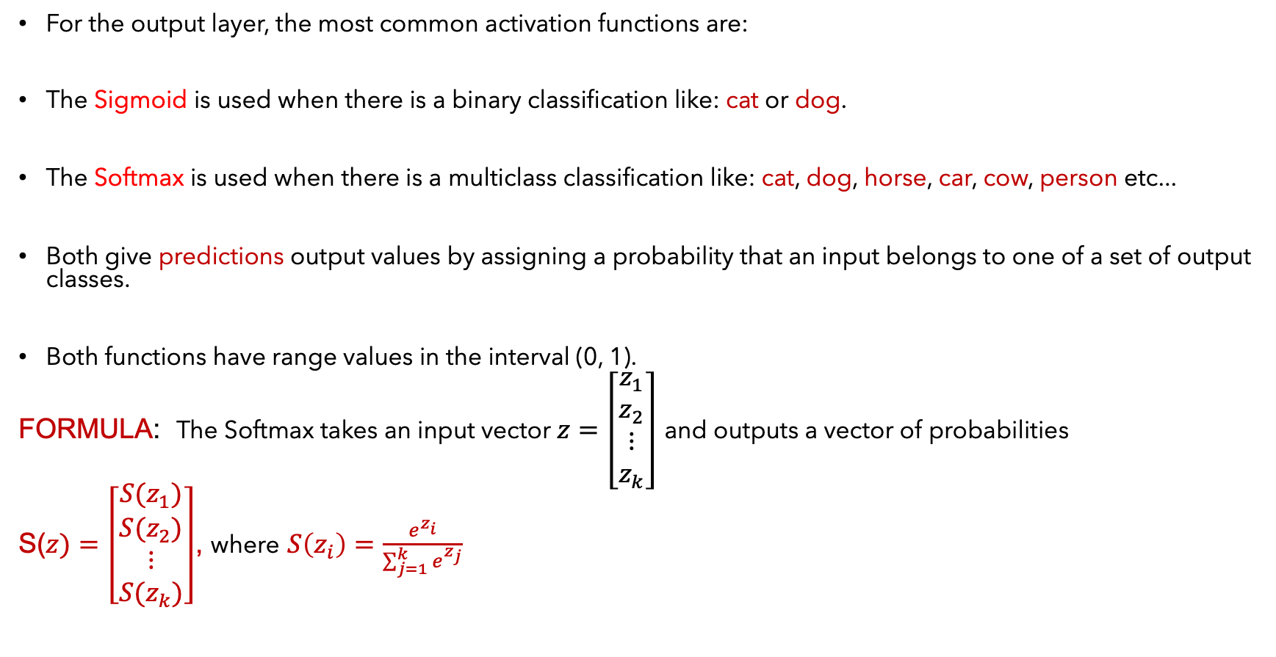
Activation Functions for the Output Layer
For the output layer, the most common activation functions are:
The Sigmoid is used when there is a binary classification like: cat or dog.
The Softmax is used when there is a multiclass classification like: cat, dog, horse, car, cow, person etc...
Both give predictions output values by assigning a probability that an input belongs to one of a set of output classes.
Both functions have range values in the interval (0, 1).
FORMULA: The Softmax takes an input vector $z=\left[\begin{matrix}z_{1} \\ z_{2} \\ \begin{matrix}⋮ \\ z_{k}\end{matrix}\end{matrix}\right]$ and outputs a vector of probabilities
S($z)=\left[\begin{matrix}{S(z}_{1}) \\ {S(z}_{2}) \\ \begin{matrix}⋮ \\ {S(z}_{k})\end{matrix}\end{matrix}\right]$, where $S\left(z_{i}\right)=\frac{e^{z_{i}}}{\sum_{j=1}^{k}{e^{z_{j}}}}$

Slide 11
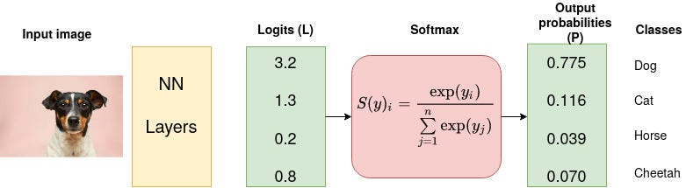
Softmax Example

Slide 12
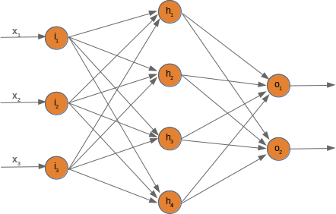
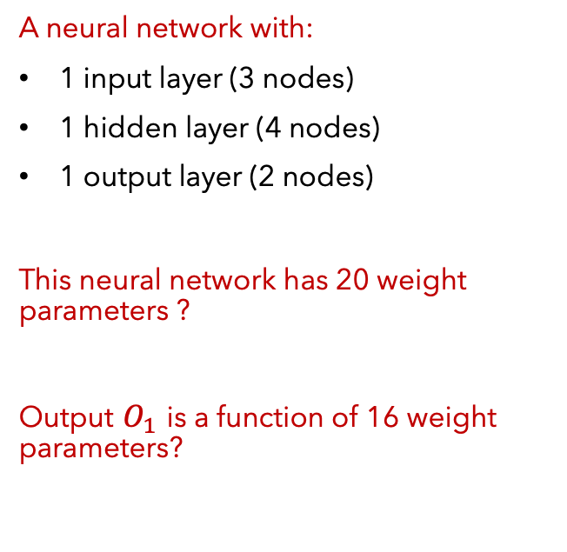
Example of a Neural Network
A neural network with:
1 input layer (3 nodes)
1 hidden layer (4 nodes)
1 output layer (2 nodes)
This neural network has 20 weight parameters ?
Output $O_{1}$ is a function of 16 weight parameters?

Slide 13
How a DNN Learns
A neural network learns to perform a task by building knowledge from training data sets so that when new data comes in, they are able to make predictions/decisions with a certain degree of accuracy based on past (learned) data.
Modes of learning: Supervised, Unsupervised, and Reinforcement.
In supervised learning, the DNN is fed a training dataset to be processed through the forward pass to the output. The output is compared to the true outcome (labels) and the difference is measured in the loss/cost function. The cost function is optimized (minimized) by adjusting the parameters (weights and biases) through the backpropagation and gradient descent.

Slide 14
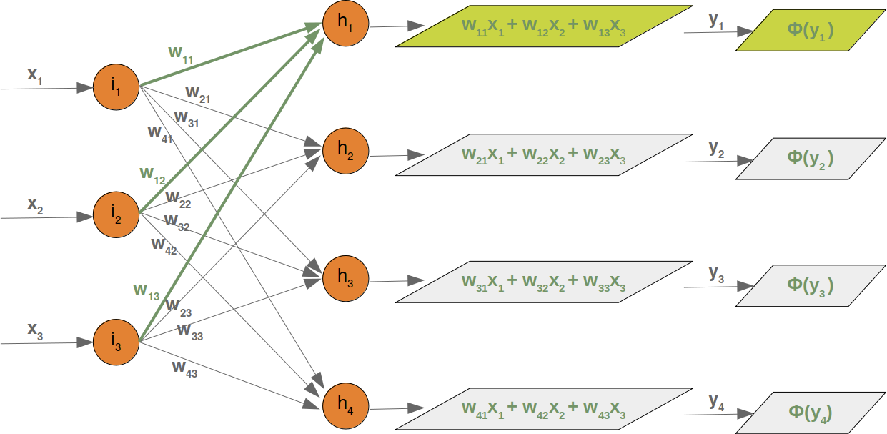
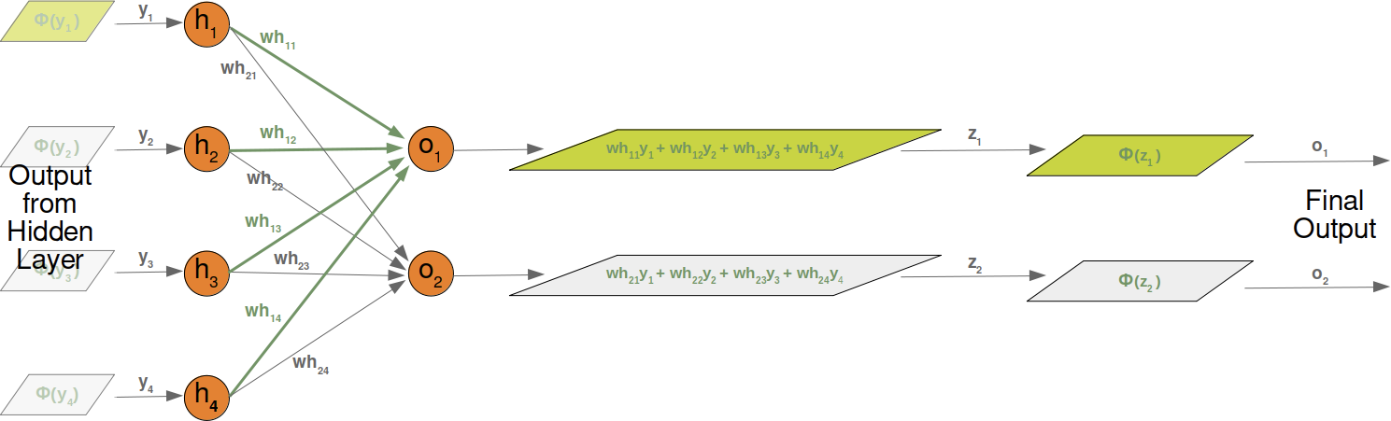
Forward Pass: Input to Output
Input to hidden layer
Hidden to output layer

Slide 15
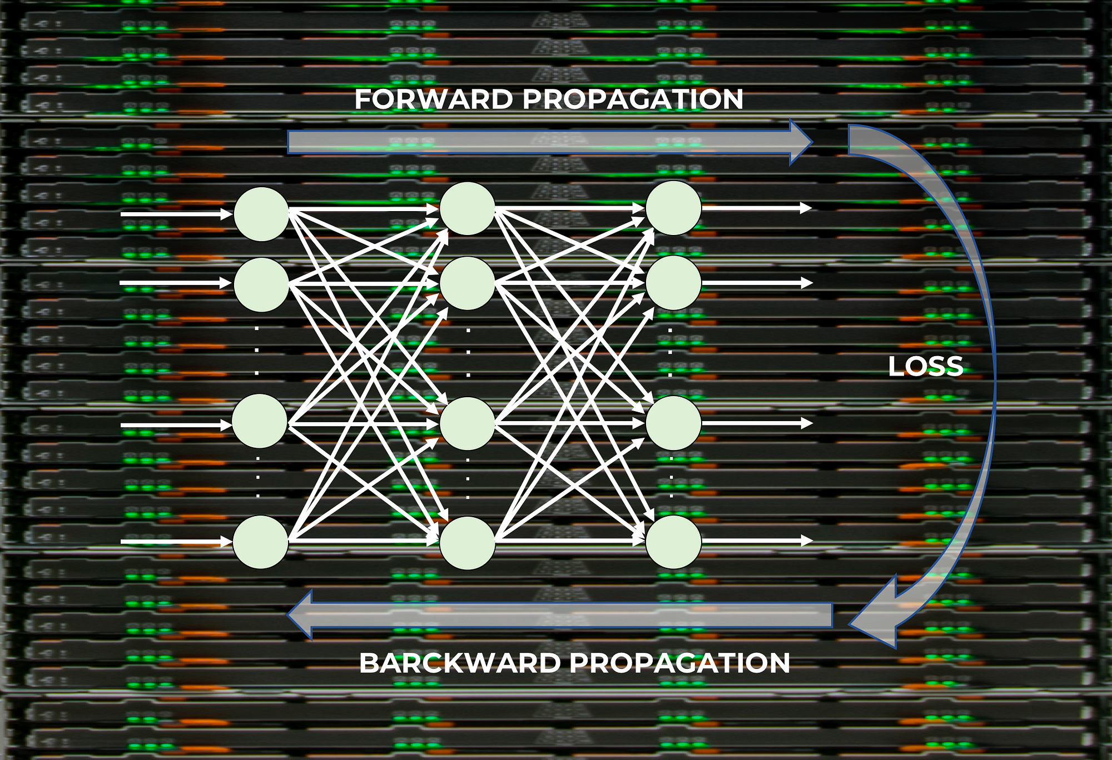
Supervised learning: Learns through corrective feedback loops to improve predictions by adjusting weights and biases iteratively.
Minimize the loss through BACK PROPAGATION.

Slide 16
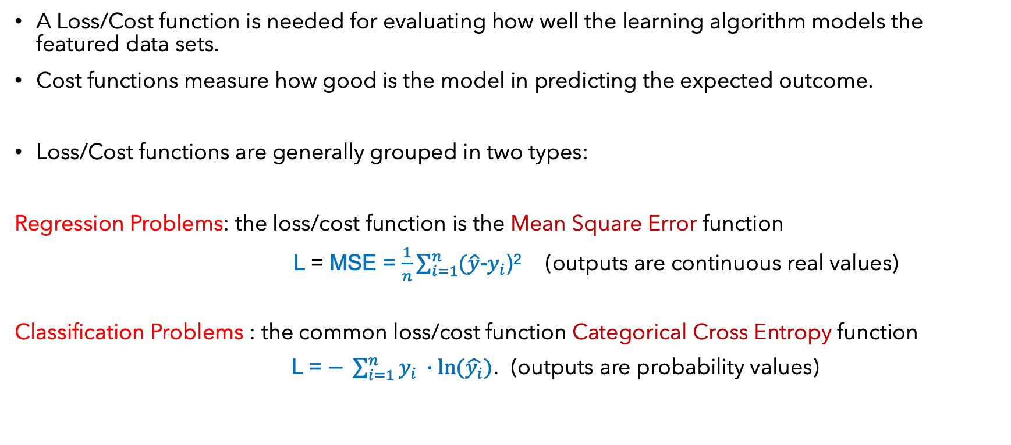
Loss Function in Supervised Learning
A Loss/Cost function is needed for evaluating how well the learning algorithm models the featured data sets.
Cost functions measure how good is the model in predicting the expected outcome.
Loss/Cost functions are generally grouped in two types:
Regression Problems: the loss/cost function is the Mean Square Error function
L = MSE = $\frac{1}{n}\sum_{i=1}^{n}{(\hat{y}}$-$y_{i}$)² (outputs are continuous real values)
Classification Problems : the common loss/cost function Categorical Cross Entropy function
L = $− \sum_{i=1}^{n}{y_{i} ∙ln⁡(\hat{y_{i}})}$. (outputs are probability values)

Slide 17
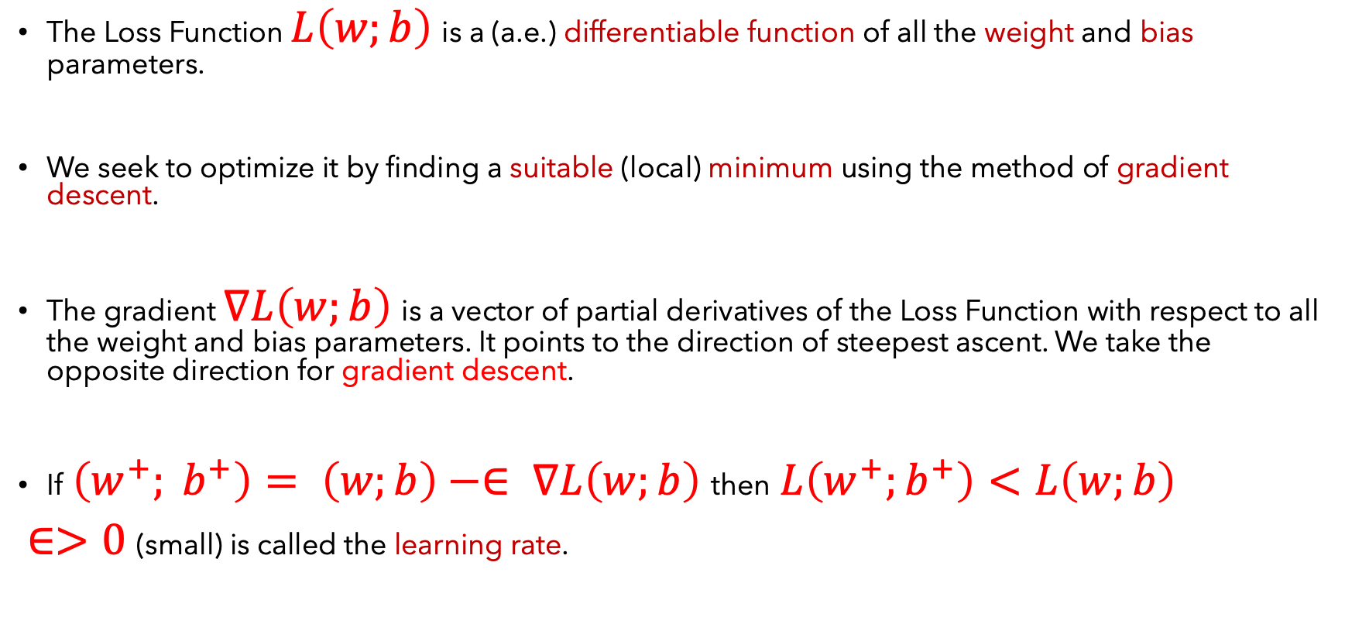
Minimize the Loss Function though gradient descent
The Loss Function $L\left(w;b\right)$ is a (a.e.) differentiable function of all the weight and bias parameters.
We seek to optimize it by finding a suitable (local) minimum using the method of gradient descent.
The gradient $∇L\left(w;b\right)$ is a vector of partial derivatives of the Loss Function with respect to all the weight and bias parameters. It points to the direction of steepest ascent. We take the opposite direction for gradient descent.
If $\left(w^{+}; b^{+}\right)= \left(w;b\right)−∈ ∇L\left(w;b\right)$then $L\left(w^{+};b^{+}\right)<L\left(w;b\right)$
$∈>0$(small) is called the learning rate.

Slide 18
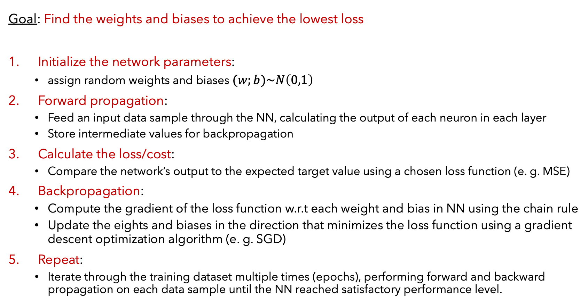
Training Neural Networks
Algorithm to train a neural network
Goal: Find the weights and biases to achieve the lowest loss
Initialize the network parameters:
assign random weights and biases $(w;b)\sim N\left(0,1\right)$
Forward propagation:
Feed an input data sample through the NN, calculating the output of each neuron in each layer
Store intermediate values for backpropagation
Calculate the loss/cost:
Compare the network’s output to the expected target value using a chosen loss function (e. g. MSE)
Backpropagation:
Compute the gradient of the loss function w.r.t each weight and bias in NN using the chain rule
Update the eights and biases in the direction that minimizes the loss function using a gradient descent optimization algorithm (e. g. SGD)
Repeat:
Iterate through the training dataset multiple times (epochs), performing forward and backward propagation on each data sample until the NN reached satisfactory performance level.

Slide 19
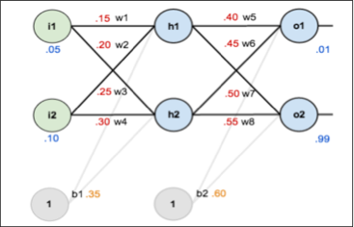

A Simple DNN Example

Slide 20
Simple DNN: Forward Pass
1 Input Layer(2 nodes)
1 Hidden Layer(2 nodes,
Activation: sigmoid)
1 Output Layer(2 nodes,
Activation: sigmoid,
labels: 0.01 and 0.99)
Compute the error/loss function L
using the MSE.

Slide 21
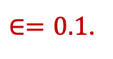
Simple DNN: Backpropagation
Compute the partial
Derivatives of the loss function L
With respect to the 8 weights and
the 2 biases.
Update the weights and biases
using the gradient descent formula
With learning rate
$∈=0.1$.

Slide 22
Simple DNN: Optimize the loss function
Compute the new value of the
loss function L using the updated
Parameters (weights and biases)
Compare the new loss value to
the original loss value.
Repeat the forward and back
propagation computations until
the loss function is brought down to
an acceptable level of accuracy

Slide 23
Summary
Deep Neural Network (DNN) is a powerful class of Machine Learning (ML) that stack several layers of neural network models together.
It consists of many layers which connect neurons to adjacent layers to solve a complex mathematical that models the predictions of a specific problem.
The input is processed by one layer, and it generates outputs for the next layer towards the output layer.
The hidden and output layers are non-linear functions that are activated by the inputs from the previous layer.
DNN is used in many application of predictive and classification analyses such as regression and image vision.

Slide 24
Exercises:
1. Use a Python like PyTorch to perform 2 epochs (forward and back propagation) of the example on pages 19-22 to compute the loss function.

Slide 25
References
Deep learning by Ian Goodfellow, Yoshua Bengio, and Aaron Courville
Hands-On ML with Scikit-Learn, Keras, and TensorFlow (Aurelien Geron)
Machine Learning with Python by Bernd Klein
LAPENNA Workshop (UTK) by Kwai Wong
6S191 MIT Deep Learning Lecture 1 by Alexander Amini
6. Dive into Deep Learning: https://d2l.ai/index.html

